Slide 1

Session 7 – Python Brief Intro to Machine Learning with Scikit Learn
Douglas Bowman

Slide 2

Overview
Overview
Definitions
General Model Types
Linear Models
Evaluating Accuracy
Tuning

Slide 3
Definition
Machine Learning
The use of a model built off of data to increase the predictive ability of a computer.
Data by itself is not machine learning if the predictive capabilities do not increase—no learning occurs in this situation.

Slide 4
Definitions
Classifier
The mathematical equation, set of equations, and/or algorithm that a computer uses to predict outcomes for classification problems.
For problems where we are trying to determine an exact value or name of something.
i.e. trying to determine what kind of fruit something is.
This is the scaffolding for our model.

Slide 5
Definitions
Regressor
The mathematical equation, set of equations, and/or algorithm that a computer uses to predict outcomes for regression problems.
Problems were we are predicting within range of values.
i.e. Predicting the median household income in the future.
This is the scaffolding for our model.

Slide 6
Definitions
Model
The classifier that is trained and filled with data.
This is what will tell us what the “answer” is.

Slide 7
Definitions
Classifier vs Model
The classifier is like a class, where the model is like an object.

Slide 8
Definition
Experience
The data used to increase the effectiveness of the model’s predictions

Slide 9
Definition
Feature
A description of a set of like-data.
This is usually represented as a column in a data table.

Slide 10
Definition
Sample
A single set of data, or a data point.
This is usually a row in a data table.

Slide 11
Definition
Label (Classification Problems)
The name associated with data point (row) for classification problems.
This is generally the thing we are trying to predict.

Slide 12
General Model Types
Supervised
Machine learning model is given a set of data to build experience with.
Data is given with features, and an algorithm is given to the model on how to best categorize and group the data.

Slide 13
General Model Types
Unsupervised
The model determines the data for itself, and builds the model accordingly.
Features and grouping data is done by the algorithm.

Slide 14
General Model Types
Reinforcement
The algorithm “learns” from making mistakes.
There must be some sort of way to tell the algorithm when it makes a correction in the right direction, and a way to tell the algorithm a correction was made in the wrong direction.
Initially, the model built is very inaccurate, but gets better with time.

Slide 15
General Model Types
This part of the Python course will focus on supervised learning, as this is all I know.

Slide 16
General Workflow
Get data
Get set of data about what we wish to predict.
Include the labels.

Slide 17
General Workflow
Build model
Select an appropriate classifier.
The model should be trained with a majority of the data we gathered, say with 75% of the data.
The other 25% can be used to test how good our model can predict.

Slide 18
General Workflow
Evaluate accuracy
The model needs to be evaluated for accuracy to ensure our predictions will have a high degree of correctness.
This is usually done using the 25% of data that we did not use for training.

Slide 19
General Workflow
Evaluate accuracy
There is no such thing as 100% accuracy unless you have toy data, or a completely defined system that does not need machine learning.
If we get 100% accuracy, and the above are not true, we have most likely over-fitted our model, possibly by using training data as test data.
Leads to inaccurate predictions on new data without known labels

Slide 20
General Workflow
Predict real-world outcomes
Once the model is as accurate as we want, the model can be used to predict real-world outcomes that are unknown.

Slide 21
Linear Models
List of some Types we will Cover
Linear Classifiers
K-Nearest Neighbors
Decision Tree
Linear Regressors
K-Nearest Neighbors
Linear Regression
Lasso
Regression
Decision Tree
Forest
Gradient-Boosted Forest

Slide 22
Linear Models - Classifiers
K-Nearest Neighbors
Predicts outcome by finding the closest matching data point neighbor(s) to the target point.
When multiple neighbors are used, the classification with the most neighbors is what the target point is classified as.

Slide 23
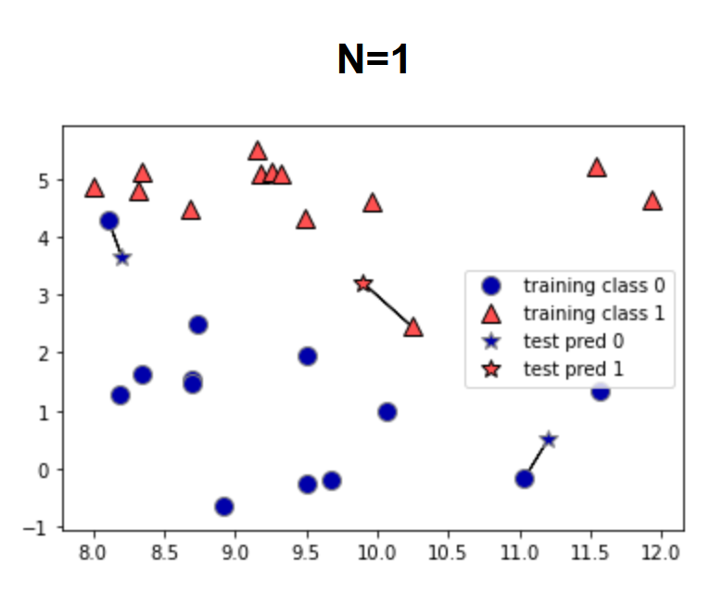
Linear Models - Classifiers
K-Nearest Neighbors
Graphs below show decision, generated in source (1). The stars are the test data, and the model is predicting whether they are blue or red.

Slide 24
Linear Models - Classifiers
Decision Tree
Builds a series of if-statements to classify test points.
Boundaries around classifications are built based on the data.
The number of if statement groups, or boundaries created, is known as the depth.

Slide 25
Linear Models - Classifiers
Decision Tree
See file “./Session 7 – Python/Instructional Material/Class Examples/Scikit-Learn/decision_tree_graph.html“ for the produced image.
Generated from iris data set
Code can be found in class example code under the decision tree section

Slide 26
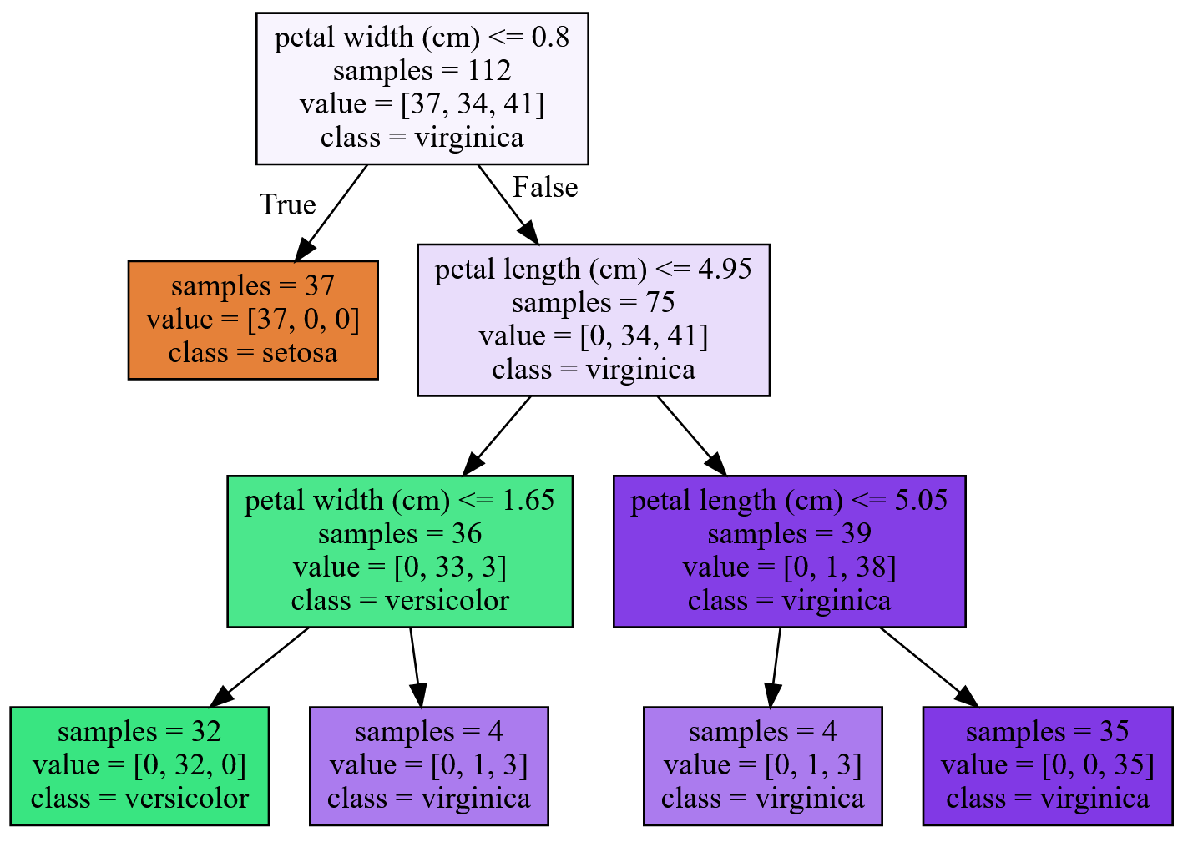
Linear Models - Classifiers
Decision Tree

Slide 27
Linear Models - Regressors
Linear Regression

Slide 28
Linear Models - Regressors
Lasso

Slide 29
Linear Models - Regressors
Regression

Slide 30
Linear Models - Regressors
Decision Tree

Slide 31
Linear Models - Regressors
Forest

Slide 32
Linear Models - Regressors
Gradient-Boosted Forest

Slide 33
Evaluating Accuracy
Overview
<model>.score(test_data, test_labels)

Slide 34
Scikit-Learn Machine Learning
Overview
Definition
General Types
Basic Linear Models
Algorithm Types
Tuning

Slide 35
Tuning
Determining what features matter

Slide 36
Tuning
Parameters to Play with
K-Nearest Neighbors
Number of neighbors to test point
Algorithm to evaluate distance test point is from data points

Slide 37
Tuning
Grid Search

Slide 38
Scikit-Learn Machine Learning
Overview
Definition
General Types
Basic Linear Models
Algorithm Types
Tuning

Slide 39

Bibliography
https://github.com/amueller/introduction_to_ml_with_python/blob/master/02-supervised-learning.ipynb

Slide 40
LICENSE
Copyright 2018 Douglas Bowman
Permission is hereby granted, free of charge, to any person obtaining a copy of this software and associated documentation files (the "Software"), to deal in the Software without restriction, including without limitation the rights to use, copy, modify, merge, publish, distribute, sublicense, and/or sell copies of the Software, and to permit persons to whom the Software is furnished to do so, subject to the following conditions:
The above copyright notice and this permission notice shall be included in all copies or substantial portions of the Software.
THE SOFTWARE IS PROVIDED "AS IS", WITHOUT WARRANTY OF ANY KIND, EXPRESS OR IMPLIED, INCLUDING BUT NOT LIMITED TO THE WARRANTIES OF MERCHANTABILITY, FITNESS FOR A PARTICULAR PURPOSE AND NONINFRINGEMENT. IN NO EVENT SHALL THE AUTHORS OR COPYRIGHT HOLDERS BE LIABLE FOR ANY CLAIM, DAMAGES OR OTHER LIABILITY, WHETHER IN AN ACTION OF CONTRACT, TORT OR OTHERWISE, ARISING FROM, OUT OF OR IN CONNECTION WITH THE SOFTWARE OR THE USE OR OTHER DEALINGS IN THE SOFTWARE.

